Slide 1
Transmutation and Decay

Slide 2
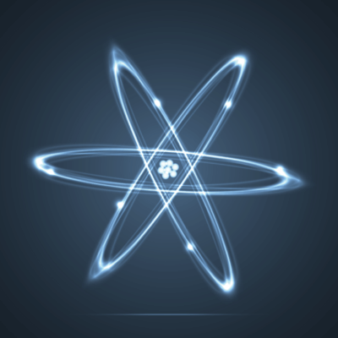
In this Smart Lesson you will learn to:
Define artificial transmutation.
Distinguish between artificial transmutation and natural radioactive decay.
Define mass defect, binding energy and binding energy per nucleon.

Slide 3
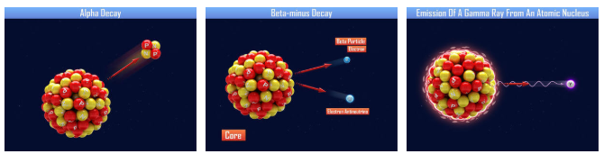
Natural radioactive decay.
Some atoms are naturally unstable and will release particles or energy to become more stable. The three types of natural radioactive decay are alpha, beta and gamma decay.
Natural radioactive decay is defined as the process by which the nucleus of an unstable atom loses energy by emitting radiation, including alpha particles, beta particles, gamma rays and electrons without artificial stimulus to do so.

Slide 4
Artificial Transmutation.
Artificial transmutation is defined as the process in which an isotope is intentionally caused to change by nuclear processes into an isotope of another element.
The term transmutation actually had a questionable beginning, as it was used by alchemists to describe the process of changing metals such as lead into gold. These claims were shown to be fraudulent, so the term was discredited.
However, early in the 20th century, natural radioactive decay was observed, and scientists began to realise that elements could be changed into different elements.

Slide 5


The first successful artificial transmutation was achieved by Patrick Blackett in 1925.
He bombarded nitrogen with alpha particles and successfully produced oxygen:
In 1932 the first nuclear fission was achieved by bombarding lithium with protons, causing it to split into 2 alpha particles:

Slide 6

So what is mass defect?
Mass defect is defined as the difference between the mass of an intact nucleus and the sum of the masses of the individual nucleons of which it is made.
Mass defect = mass of nucleus − mass of nucleons
The mass of the nucleons is calculated by multiplying the mass of a proton by the number of protons, plus the mass of a neutron by the number of neutrons.
So why do separate particles weigh more than when they are joined together in a nucleus?

Slide 7
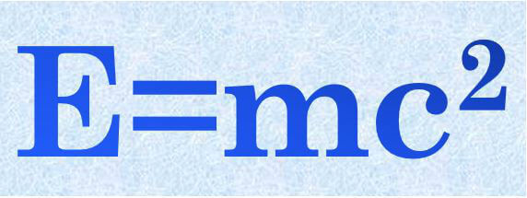
The answer is binding energy!
Binding energy is the mechanical work that must be done against the forces holding a nucleus together to disassemble it into component parts.
Basically, some of the mass of the nucleons is converted into energy to hold the nucleus together!
The mass is the mass defect.
The binding energy is the energy equivalent of the mass defect.

Slide 8
Is the binding energy the same for a nucleon in different atoms?
To answer this you need to calculate the binding energy of each nucleon.
The binding energy per nucleon is the binding energy divided by the number of nucleons in the nucleus of an atom.
If this is plotted against atomic mass, it shows that as you increase mass from hydrogen through the lighter elements, the binding energy per nucleon increases. This is due to higher forces between the increasing nucleons. In heavier elements there is less change in binding energy per nucleon, eventually decreasing slightly due to the impact of electromagnetic forces.

Slide 9
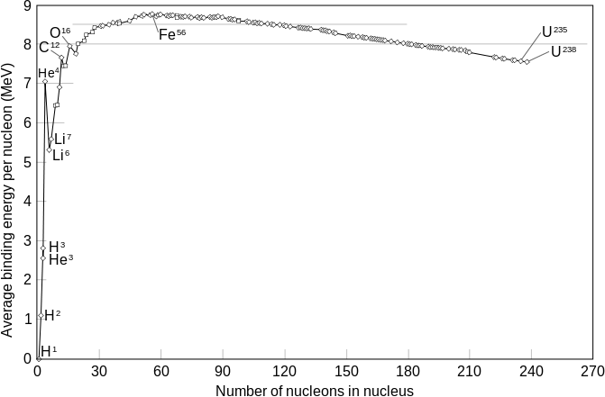

Slide 10
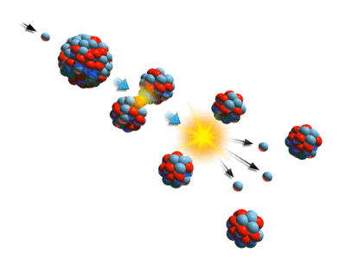
Nuclear fission (the process of splitting the atom) releases huge amounts of energy.
Some of the mass in the original, unstable atom is converted into energy. We will look at the fission of uranium-235 to find the mass defect, and calculate the energy released.

Slide 11


Artificial transmutation of uranium-235.
This equation shows uranium-235 splitting into xenon-140 and strontium-94 through nuclear fission. Notice that one neutron is used to induce the reaction, and two neutrons are produced.
We will do our mass calculations in unified atomic mass units (u) rather than kilograms. This is because the mass in kilograms is incredibly small, and using unified atomic mass units makes our calculations easier.

Slide 12
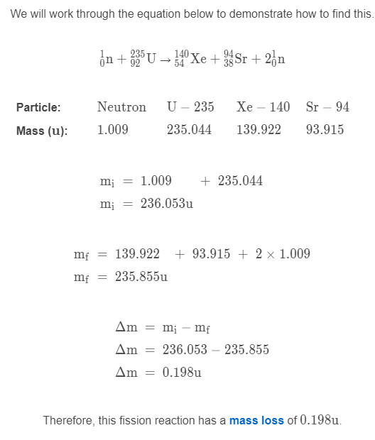
The mass loss is found by initial mass minus final mass.
We will work through the equation below to demonstrate how to find this.

Slide 13
